Slide 1
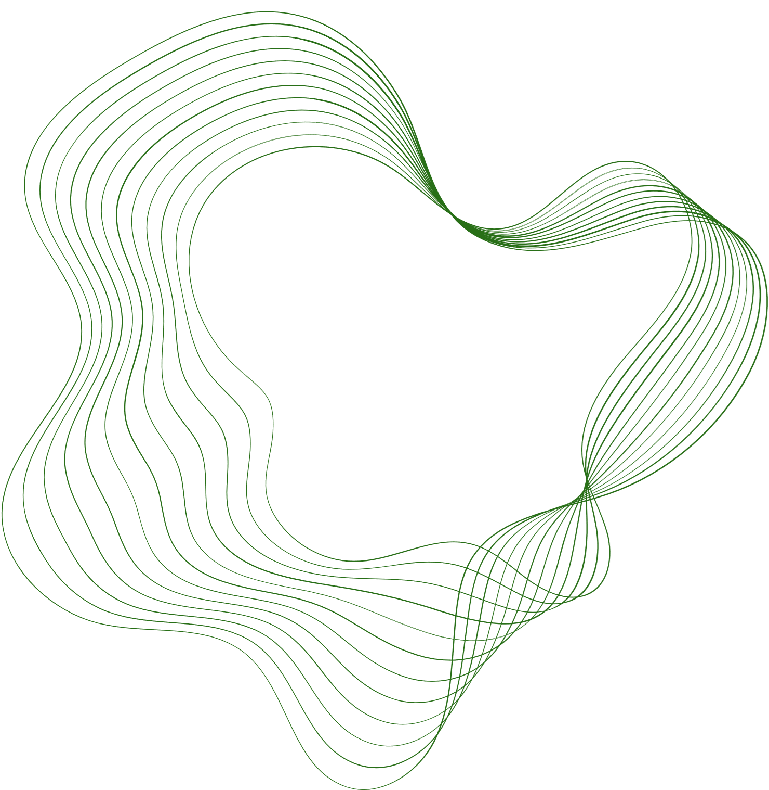


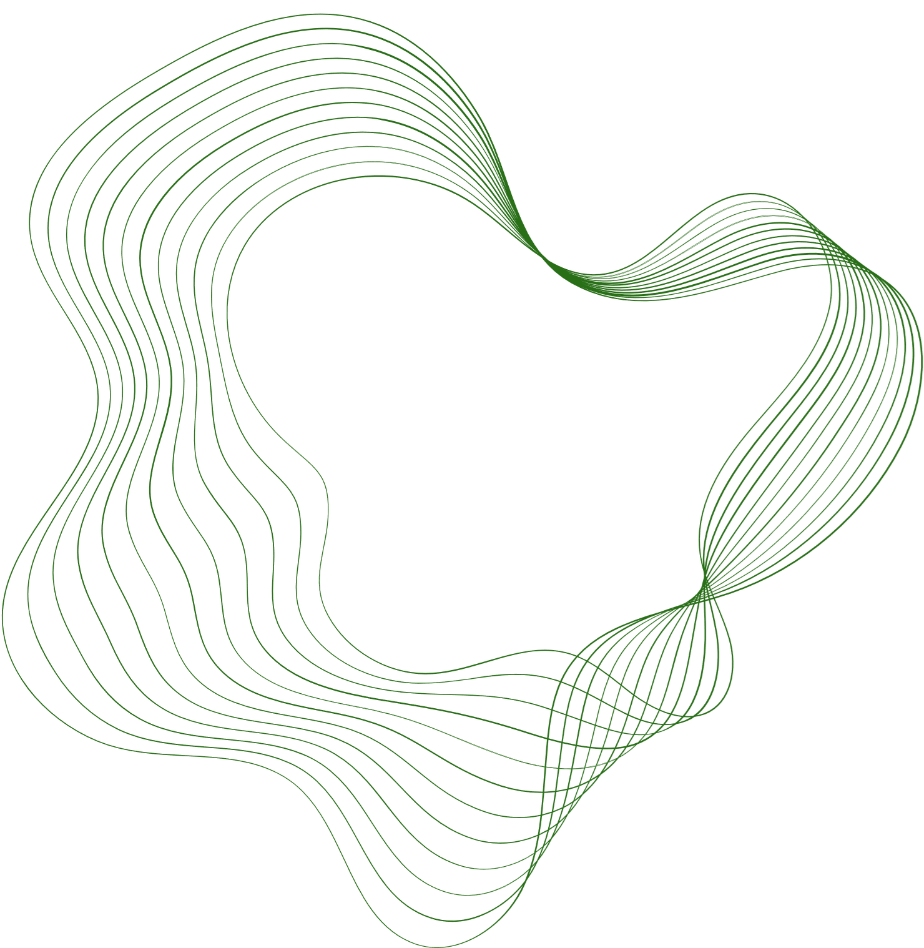
ARKA Educational Cultural Trust(R) Jain Institute of Technology , Davangere Affiliated to VTU Belagavi | Approved by AICTE New Delhi and Government of Karnataka
Major Project Presentation
On
“MULTI-MODEL AI APPROACH FOR CROP-ADVISOR AND DISEASE DETECTOR”
PRESENTED BY:
Computer Science and Engineering
Sandeep S K 4JD22CS092
Veeresh G S 4JD22CS118
Niranjan R M 4JD22CS077
Sanjay G M 4JD22CS095
UNDER THE GUIDENCE:
Ms. Rashmi S P
Assistant Professor,
Dept. of CS&E,
Jain Institute of Technology, Davangere

Slide 2




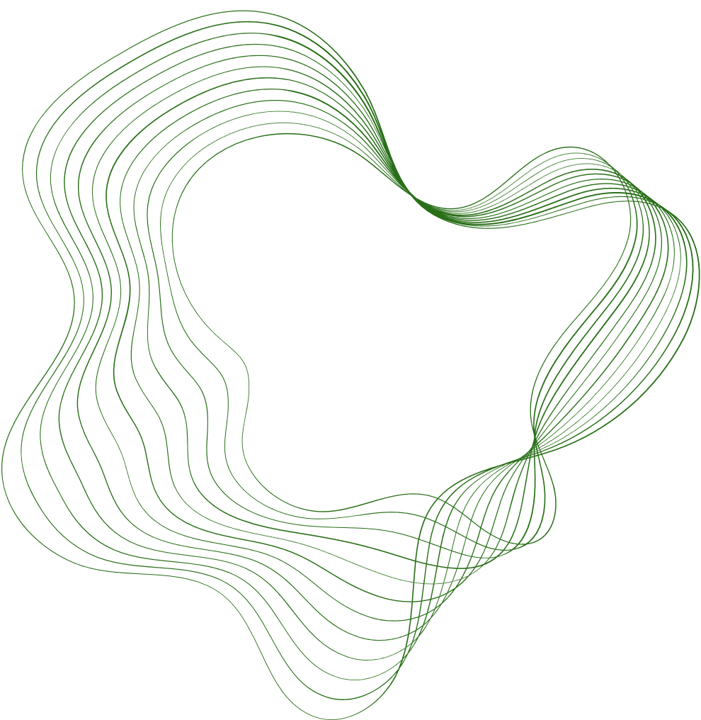
1.INTRODUCTION
Agriculture remains vital but farmers still struggle with crop planning, soil management, and disease control.
Technology integration is essential for sustainable and efficient farming.
This project introduces an AI-powered chatbot to support farmers with real-time guidance.
The system answers agricultural queries, recommends suitable crops based on soil parameters, and detects plant diseases using image analysis.
By combining ML, NLP, and image recognition, the chatbot helps improve decision-making, boost productivity, and promote sustainable farming. practices.

Slide 3
2.LITERATURE SURVEY
EXISTING PROJECT | AUTHORS | TECHNOLOGY USED
Crop Pest and Disease Detection | Nirmal Sankalana · Updated 2 years ago https://www.kaggle.com/datasets/nirmalsankalana/crop-pest-and-disease-detection | Convolutional Neural Networks (CNNs) Pre-processing and Standardization Evaluation metrics
Lemon Leaf Disease Dataset (LLDD) | Mahmoud Shaheen · Updated 7 months ago https://www.kaggle.com/datasets/mahmoudshaheen1134/lemon-leaf-disease-dataset-lldd | Deep Learning / Convolutional Neural Networks Data Pre-processing Validation and Testing Data Augmentation
ML based crop and fertilizer recommendation and disease detection | Praise Odhiambo https://github.com/godwins3/agro.ai | Model inference / logic Web Framework Flask
PlantDiseaseT3 | DestinyHub · Updated 7 months ago https://www.kaggle.com/datasets/destinyhub/plant-disease-t3 | Train / Validation / Test splits Loss function and optimizer Optional: Explainability / Visualization

Slide 4
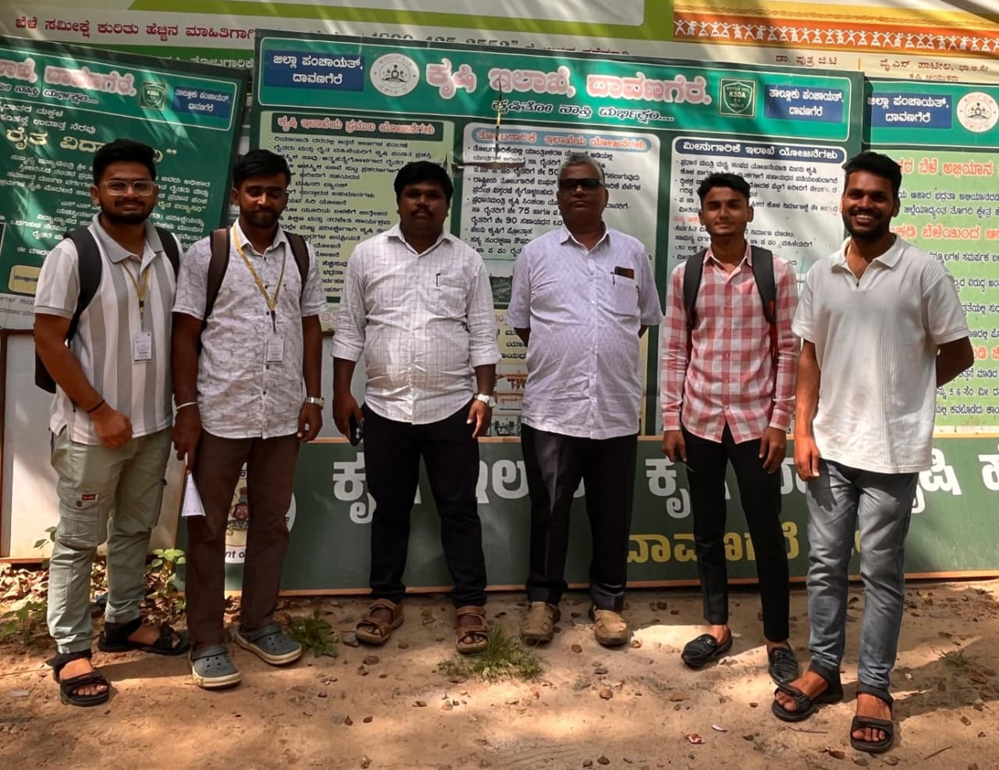
DATASET COLLECTED FROM KRISHI ILAKE
(AGRICULTURE OFFICE)
Fig. We are visited the Agri Office to collect the information and Real-world Data set from Agri Office

Slide 5
3.Problem Statement
Farmers often struggle to make accurate crop decisions due to limited knowledge of soil requirements, weather conditions, and suitable crop varieties. Existing systems provide generic recommendations and lack intelligent automation, resulting in lower productivity and increased losses.

Slide 6

EXISTING
SYSTEM

Slide 7

EXISTING SYSTEM
This AI-powered farming chatbot integrates XGBoost, ResNet, and SVM to provide intelligent crop recommendations and accurate plant disease detection.
It delivers real-time, data-driven insights by analyzing soil parameters and plant images.
The system supports farmers with better crop selection, early disease identification, and more informed agricultural decisions.
Overall, it boosts productivity, reduces crop losses, and encourages efficient and sustainable farming practices.
80%
ACCURACY

Slide 8
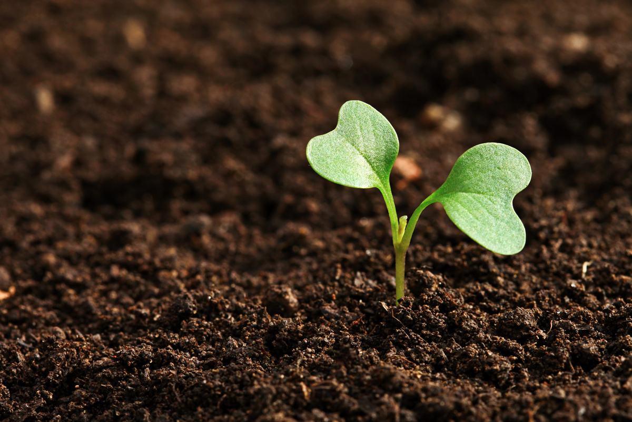
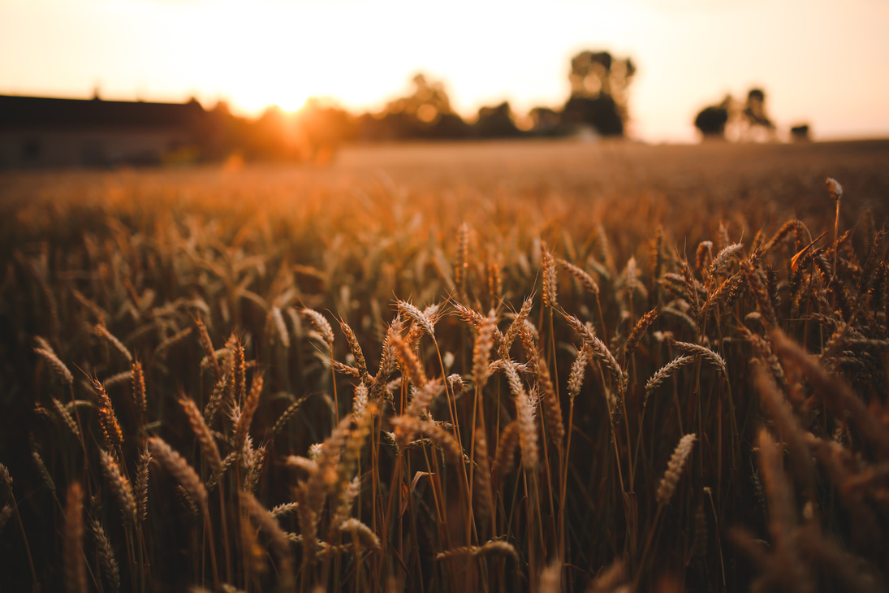
DISADVANTAGES
1
High Computational Cost:
SVMs can be computationally intensive, especially with large datasets. Training time increases significantly with the number of samples, making it less suitable for large-scale applications.
2
Memory Consumption:
SVM requires storing and processing a large number of support vectors, which can lead to high memory usage, particularly for large datasets.

Slide 9
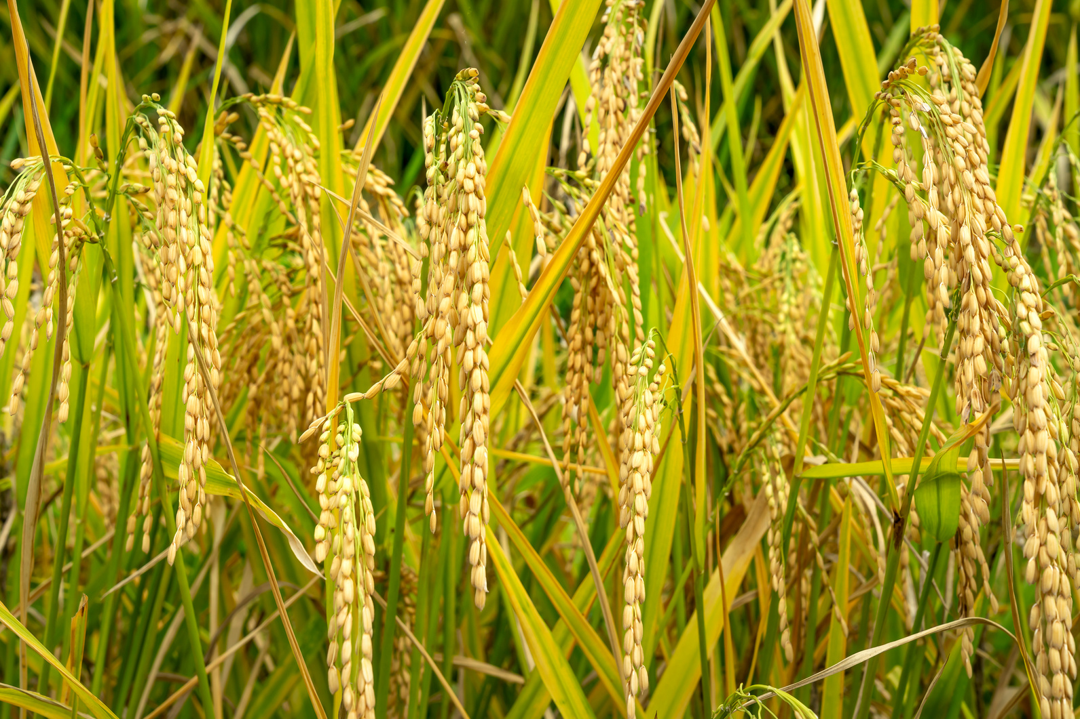
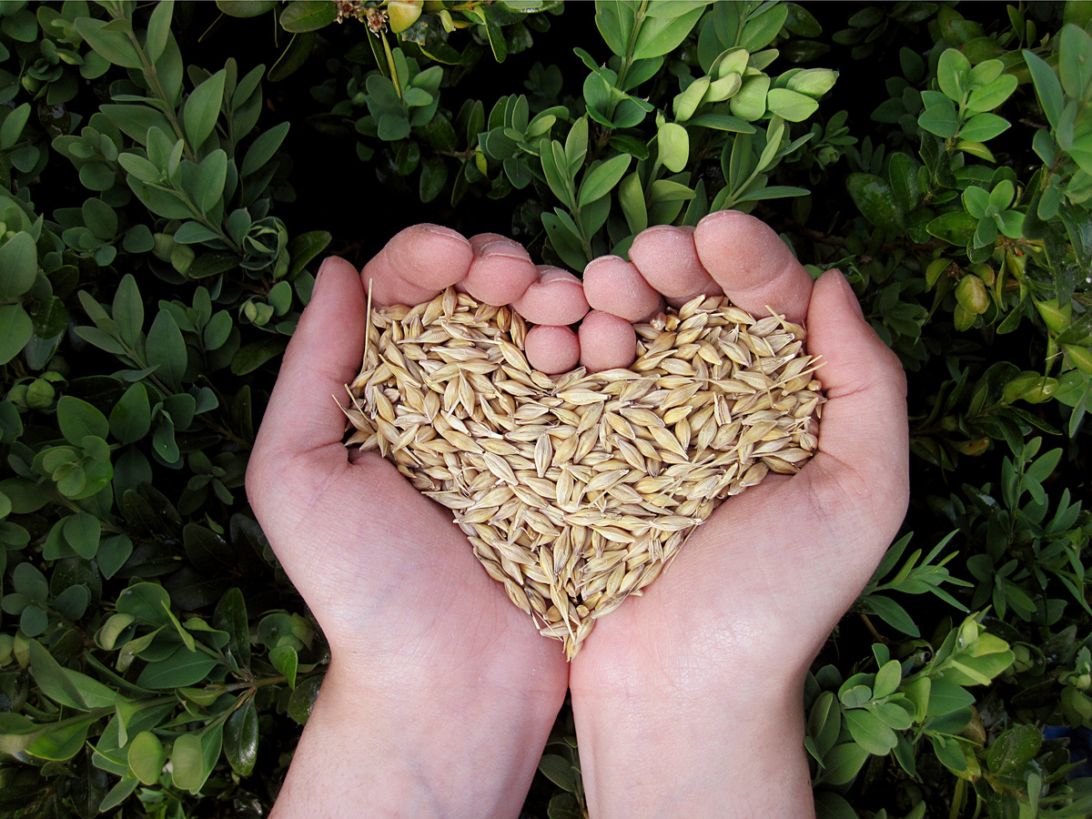
DISADVANTAGES
3
Difficult to Interpret:
SVM models, particularly those with non-linear kernels, are often considered black-box models, making them difficult to interpret and understand, which can be a drawback when transparency is required.
4
Limited Flexibility:
SVMs are less flexible in capturing complex patterns in data compared to some other machine learning models, such as neural networks, which might limit their effectiveness in complex, multi-dimensional problems like career recommendations.

Slide 10


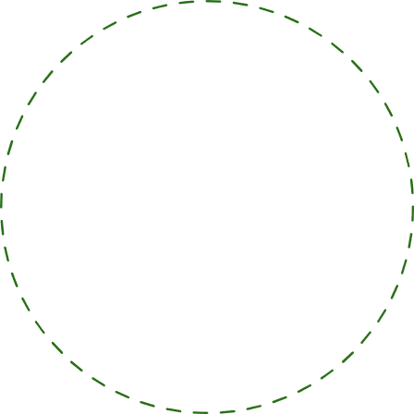


4.GOALS AND OBJECTIVES
Objective n° 1
Objective n° 2
Objective n° 3
Provide Instant Agricultural Support: Develop an AI-driven chatbot capable of answering a wide range of queries
Personalized Crop Recommendations: Implement a system that recommends the most suitable crops based on real-time analysis of soil parameters
Disease Prediction via Image Analysis: Create a machine learning-based image recognition tool that can accurately predict plant diseases

Slide 11
PROPOSED
SYSTEM

Slide 12
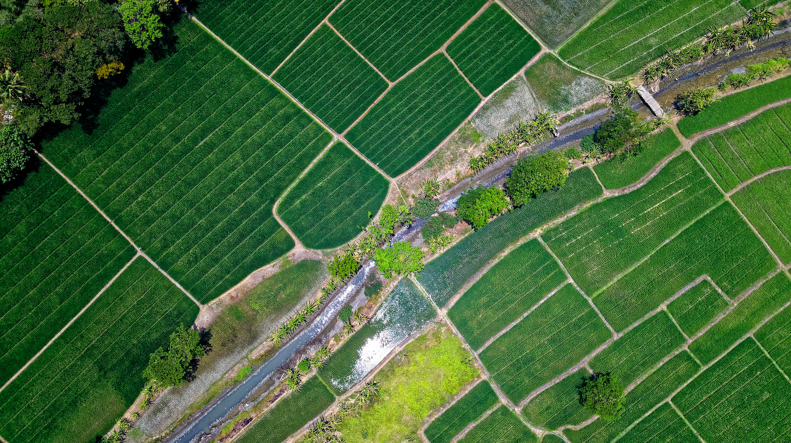
PROPOSED SYSTEM
The system is an AI-powered chatbot that assists farmers with personalized crop recommendations and plant disease prediction through image analysis.
Uses the XGBoost algorithm to analyze key soil parameters like pH, moisture, and nutrient levels.
Recommends the most suitable crops for improved yield, better decision-making, and sustainable farming practices.

Slide 13
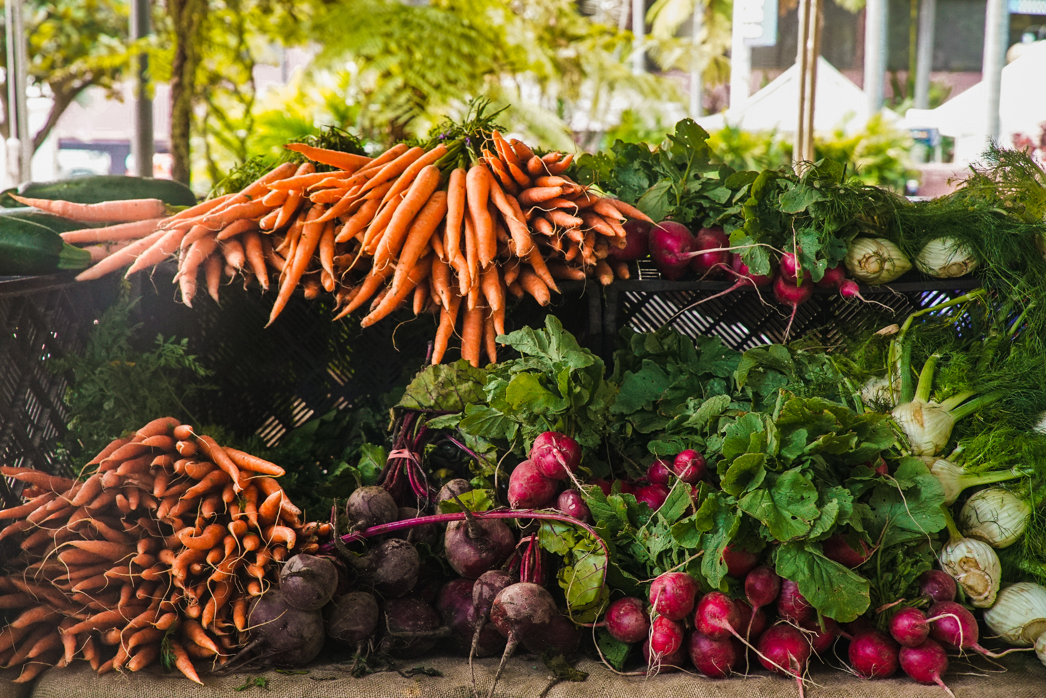
PROPOSED SYSTEM
Uses ResNet (Residual Neural Network) to accurately classify plant diseases from uploaded crop images.
Farmers can upload photos of affected plants; the model identifies the disease and provides treatment suggestions.
Combines ResNet for image-based detection and XGBoost for decision-making, creating a robust and scalable solution.
Helps improve productivity, reduce crop losses, and enhance agricultural efficiency.

Slide 14
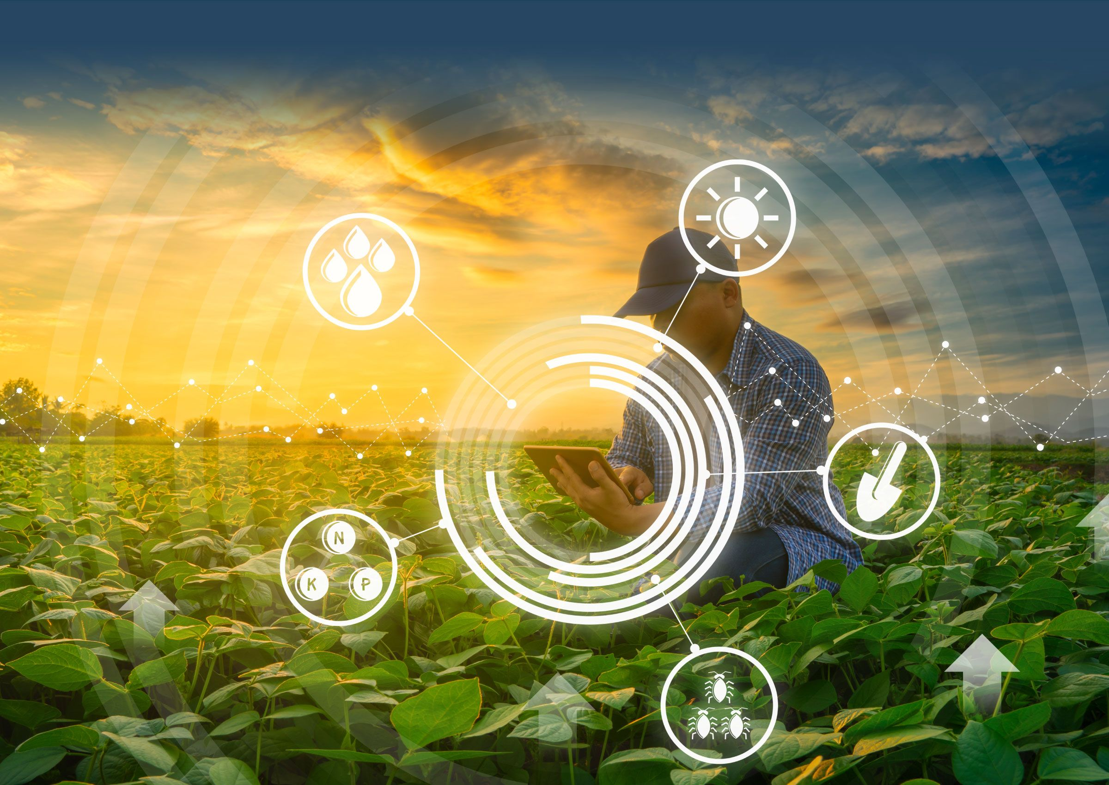
5. Methodology
Data Collection
Chat-Bot Development
Model Training
Model Evaluation
Feature Extraction
Deployment and Testing

Slide 15


01
02
03
04
DATA COLLECTION
CHATBOT
DEVELOPEMENT
MODEL TRAINING
TESTING & DEPLOYMENT
Deploy the chatbot as a web or mobile application accessible to farmers.
Ensure real-time functionality for answering queries, crop recommendations, and disease detection.
Collect relevant soil data (pH, moisture, nutrient levels) and plant disease image datasets.
Compile a dataset containing various crop types, their soil requirements, and corresponding optimal conditions.
Gather image datasets of common crop diseases to train the ResNet model.
Develop a chatbot using Natural Language Processing (NLP) to understand and respond to farmers' queries.
Integrate the XGBoost model to provide real-time crop recommendations when farmers input soil parameters.
XGBoost Model:
Train the XGBoost model using soil data to classify and recommend suitable crops based on input parameters like pH, moisture, and nutrients.
ResNet Model:
Train the ResNet model on the disease image dataset to classify plant diseases based on visual characteristics.

Slide 16
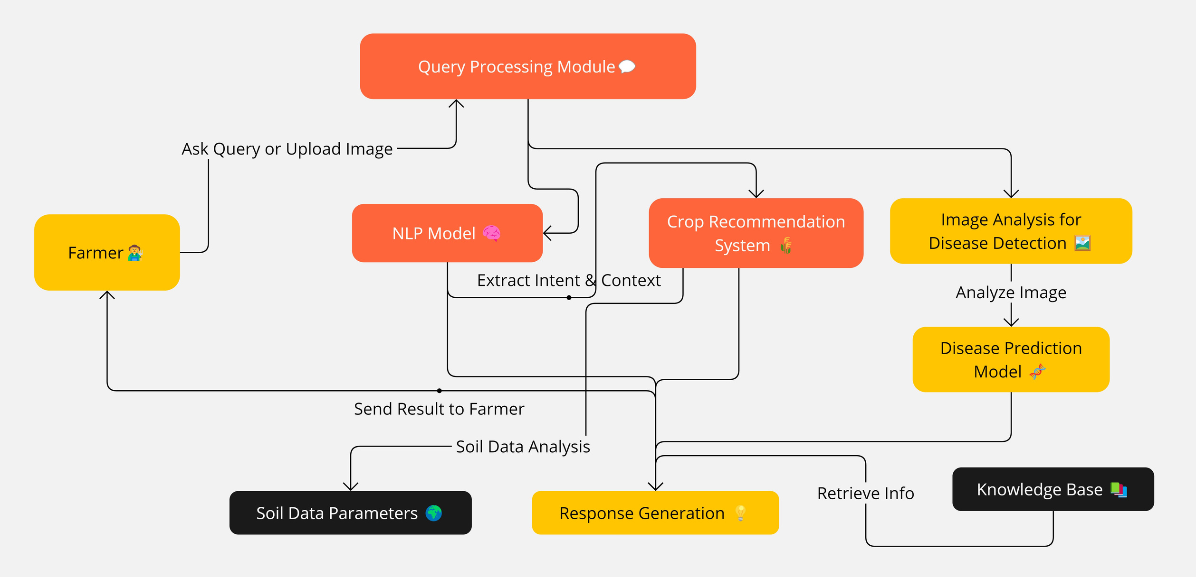
6.System Design

Slide 17
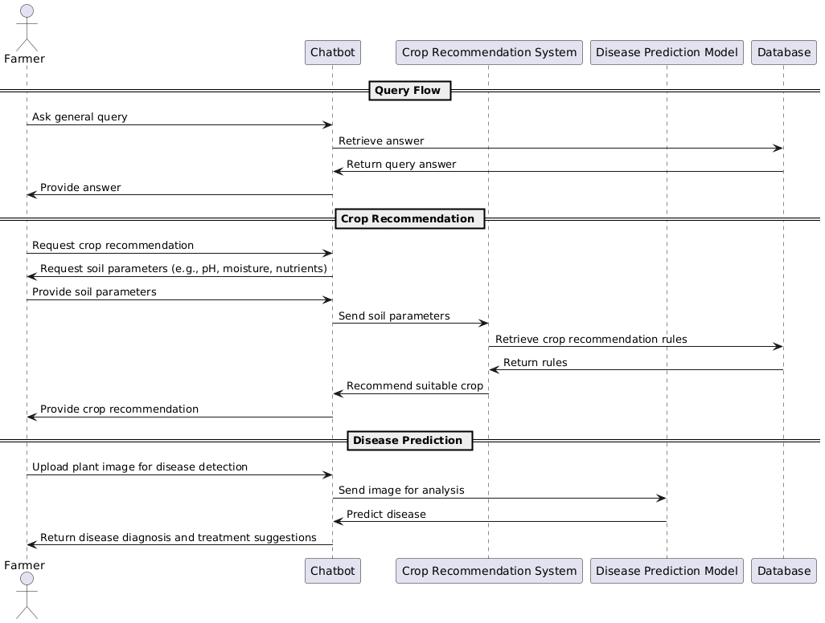
UML DIAGRAM

Slide 18

ADVANTAGES
High-Accuracy Crop Recommendation: XGBoost analyzes soil parameters (pH, moisture, nutrients) to give precise and reliable crop suggestions.
Efficient Disease Detection: ResNet model accurately identifies plant diseases from images, ensuring timely and correct diagnosis.
Real-Time Farmer Support: The chatbot provides instant answers for crop selection and disease management, reducing effort and reliance on experts.
97%
ACCURACY

Slide 19
7.IMPLEMENTATION
7.1 Overview
Data Acquisition Pipeline: Crop images and environmental inputs are collected, preprocessed, and normalized using Python and OpenCV.
ML Model Integration: A RestNet deep learning model classifies plant diseases with high accuracy using trained agricultural image datasets.
Crop Recommendation Engine: Soil parameters and user-provided inputs are analyzed using a machine-learning model to suggest the most suitable crops.
AI Assistance: An integrated AI Chatbot provides real-time farming guidance, answering queries related to crop care, fertilizers, and disease prevention.

Slide 20
7.2 Algorithm
Input:Text query, leaf image, or soil parameters provided by the farmer.
Output:Recommended crops, disease detection results with confidence, treatment suggestions, and chatbot guidance.
Step 1: Classify user input as text, image, or soil data using the Query Processing Module.
Step 2: Apply the NLP model to extract intent and key entities from text queries.
Step 3: Preprocess soil parameters for model-ready feature vectors.
Step 4: Use the XGBoost model to generate crop recommendations based on processed soil data.
Step 5: Preprocess uploaded images and run them through the ResNet model for disease classification.
Step 6: Fetch relevant treatment or crop-care information from the Knowledge Base.
Step 7: Integrate outputs from NLP, XGBoost, ResNet, and the Knowledge Base to produce the final user response.

Slide 21
8.Testing
8.1 Overview
1. To ensure soil data is accurately preprocessed and fed into the XGBoost model for reliable crop recommendation output.
2. To confirm that uploaded leaf images are properly cleaned, normalized, and classified using the ResNet model with correct disease predictions
3. To make sure the Knowledge Base returns accurate treatment, fertilizer, and crop- care information based on model predictions.
4. To ensure all generated results (crop suggestions, disease labels, chatbot replies) are correctly displayed on the Django web dashboard hosted via WAMP.

Slide 22
8.2 Types of Testing
Unit Testing
🔹Verifies individual components such as
SHA-256 hash generation
Log parser functions
Suspicious rule functions
4. User Interface Testing
Ensure the dashboard loads correctly in the browser
Verify hash records and suspicious activities are displayed properly
Check graphs/charts are visible and accurate
2. Functional Testing
🔹Confirms that core system features work end-to-end:
Log loading
Hash generation
Blockchain recording
Suspicious activity detection
CSV export
3. Integration Testing
🔹Ensures proper interaction between modules:
Data preprocessing ↔ Hashing
Hashing ↔ Blockchain
Detection engine ↔ Dashboard (Flask)

Slide 23
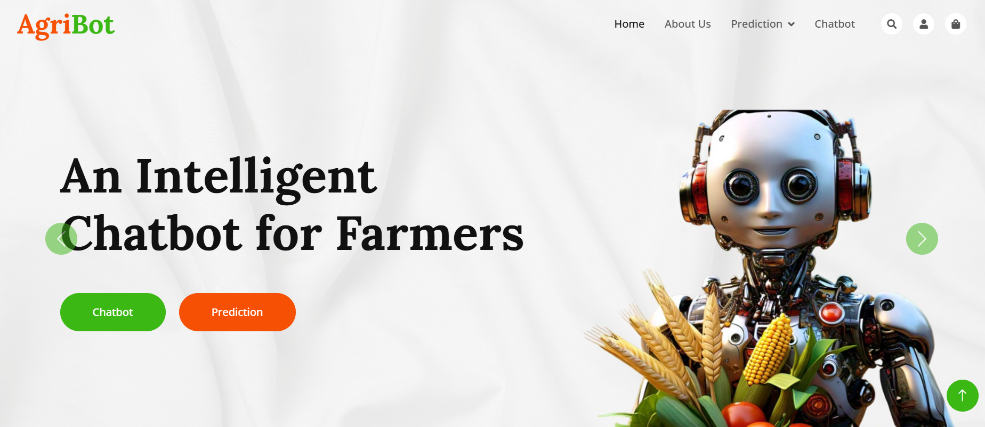
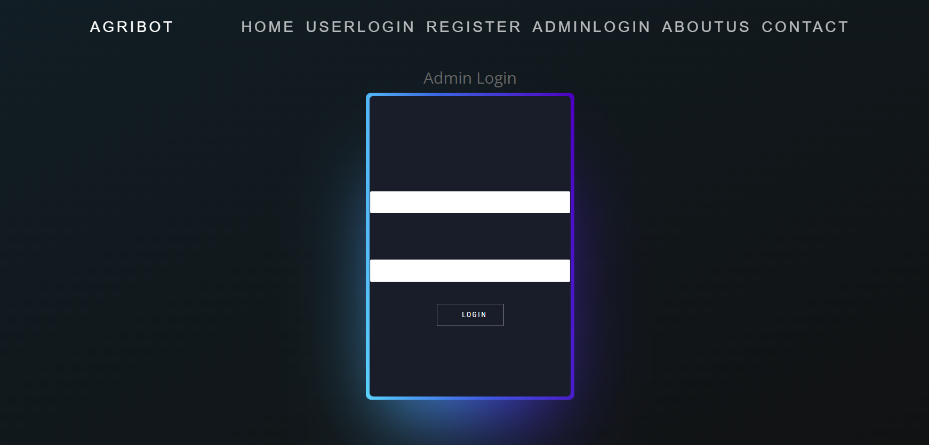
RESULTS
Fig 1. Home page of users
Fig 2. Admin Login Page

Slide 24
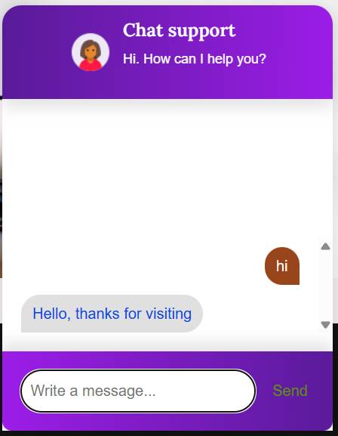
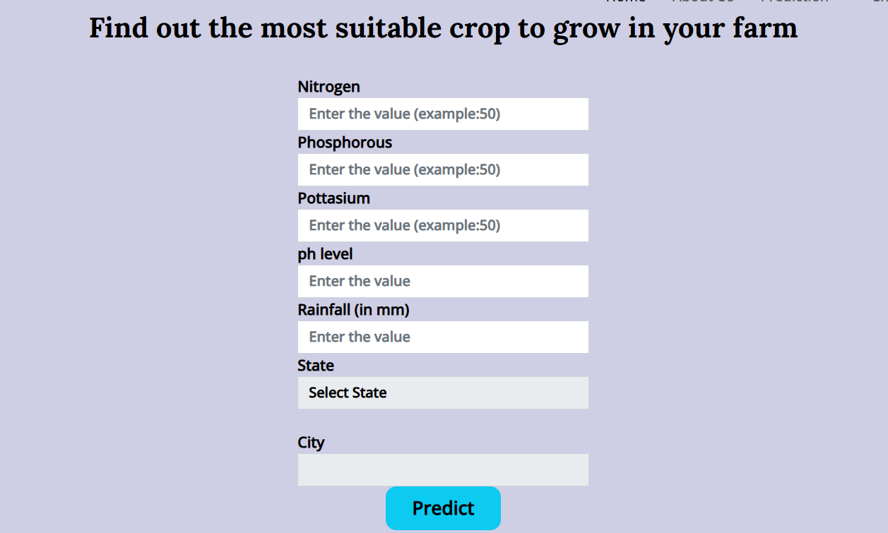
01
03
4
Fig 3. Agri Chatbot
Fig 4.Crop Prediction based on entities

Slide 25
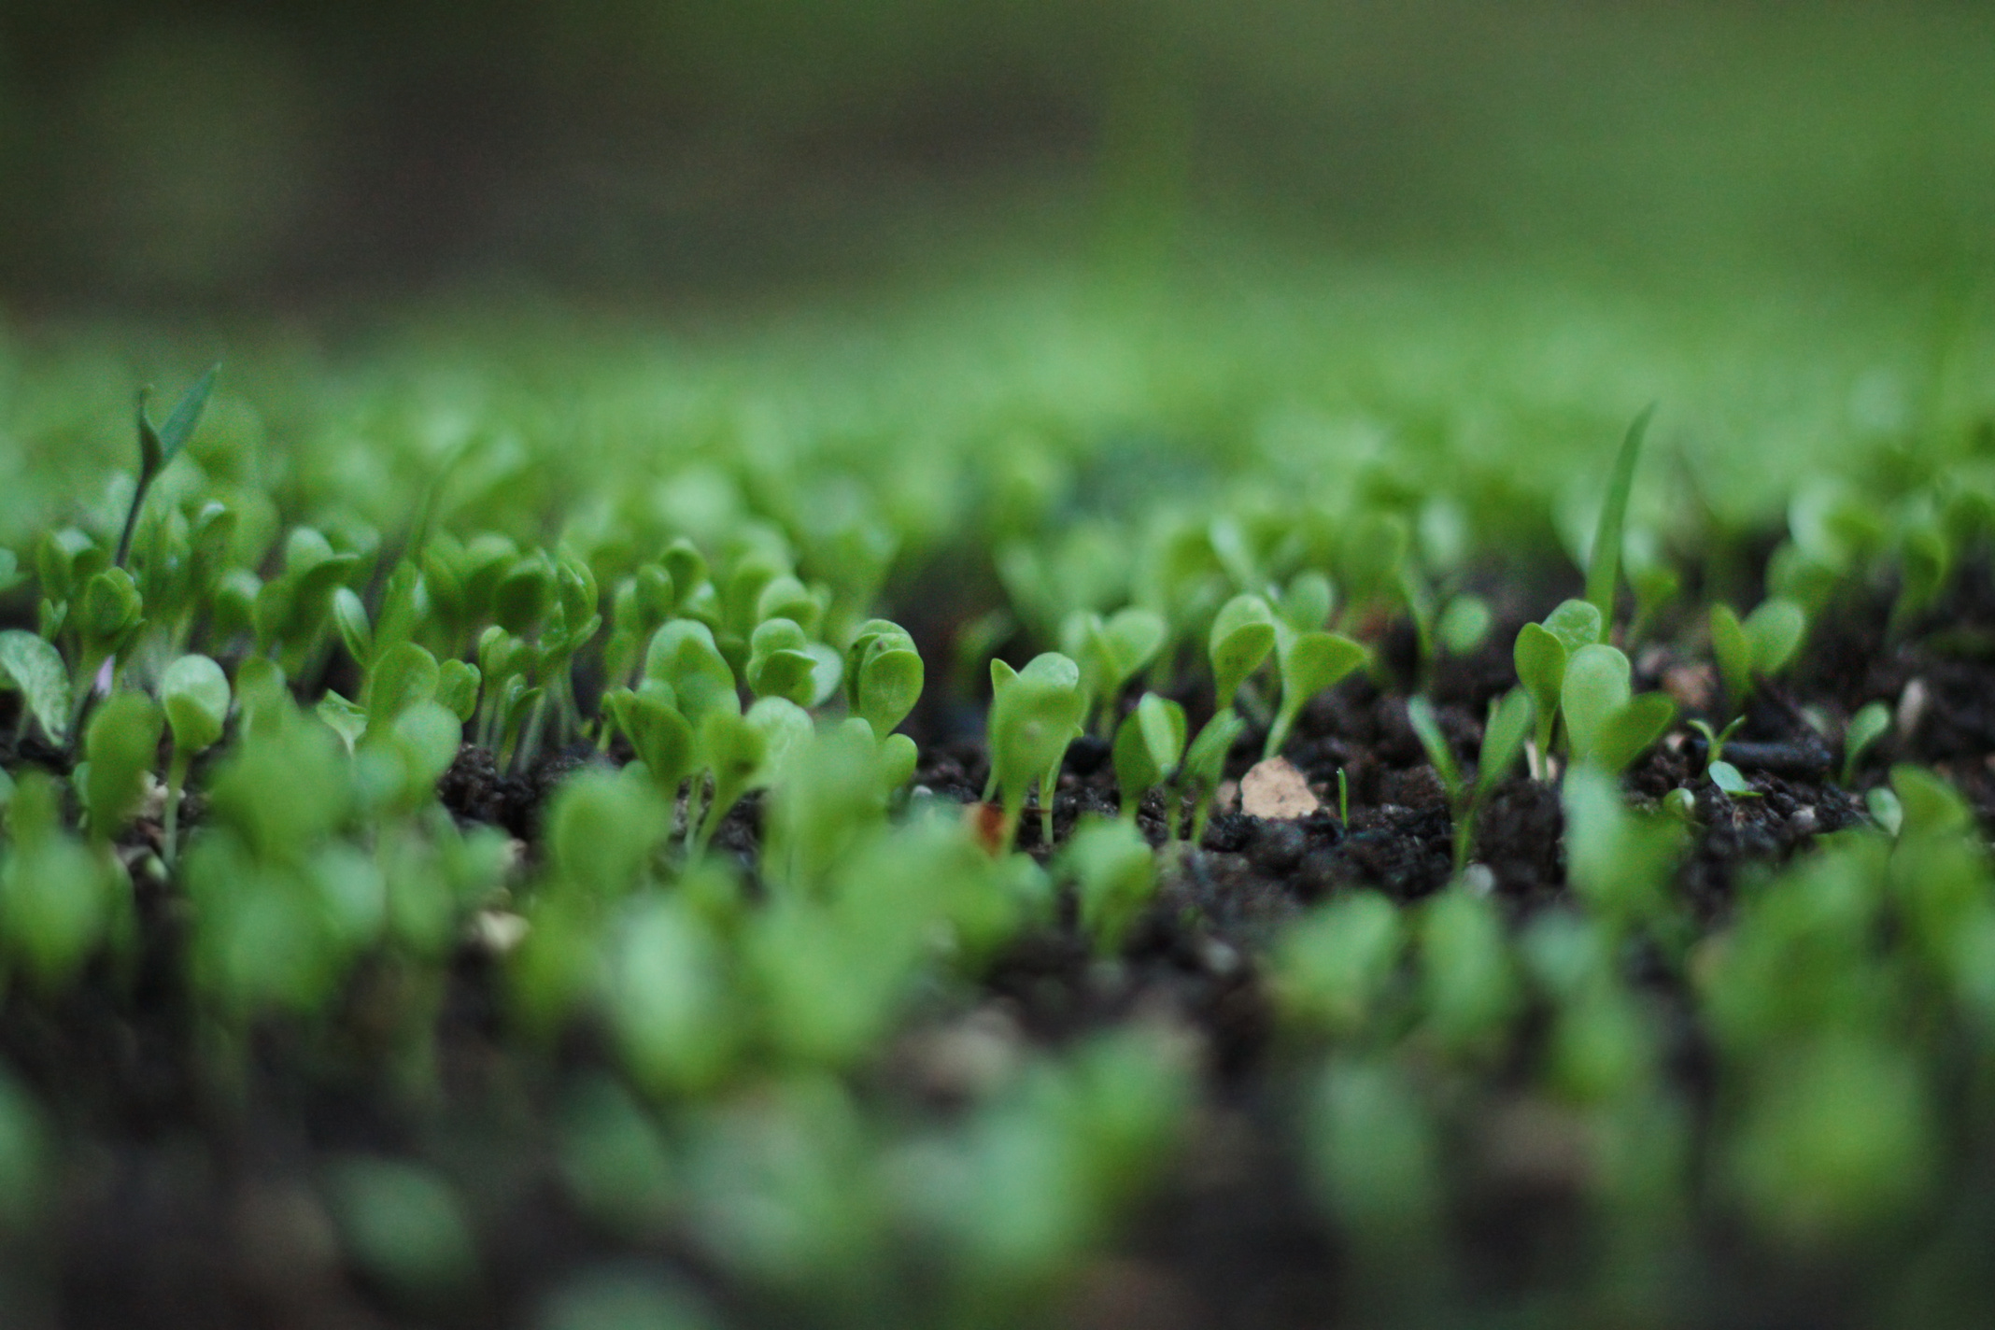

CONCLUSION
AI-powered chatbot using XGBoost for crop recommendations and ResNet for disease detection.
Provides real-time, data-driven insights to support farmers.
Helps with accurate crop selection, early disease identification, and better farm decisions.
Enhances productivity, reduces losses, and promotes sustainable agriculture.

